Slide 1
Esperto. Smart Mirror Using IoT
Abdul Muhaimin.T
Ayman Vajeeh .BP
Jithin Raj.MK
Muhammed Jaseel .A
Project Guide :
Mr. Ashrafali TPO

Slide 2
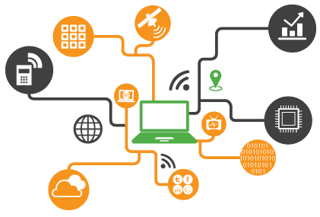
What is IoT ?
Internet of Things (IoT) is an ecosystem of connected physical objects that are accessible through the internet.
Our Project and IoT.
Every gadget is becoming smart day by day with the help of IoT. Our project is just an addition to this ecosystem. We are using IoT gadgets in our project.

Slide 3
Smart Mirror
A “Smart Mirror” is a device that acts as a traditional mirror while also superimposing informational data such as time, weather, news and other useful information.
Features of Smart Mirror.
Ability to display scalable widgets
Clock
Weather
Music
News
Calendar
Google assistant and Alexa support
Automatic timed on and off
Person detection
Can be configured using android application
10:10
30°C
News
Calendar
Music
YT

Slide 4
Hardware Components
Two way mirror
LCD/LED Monitor
Wooden Frame
Raspberry PI : ARM based mini computer
ESP8266 : Microcontroller with Wi-Fi
Power adapters
Speaker
Microphone
Sensors : PIR / UltraSonic
LEDs

Slide 5
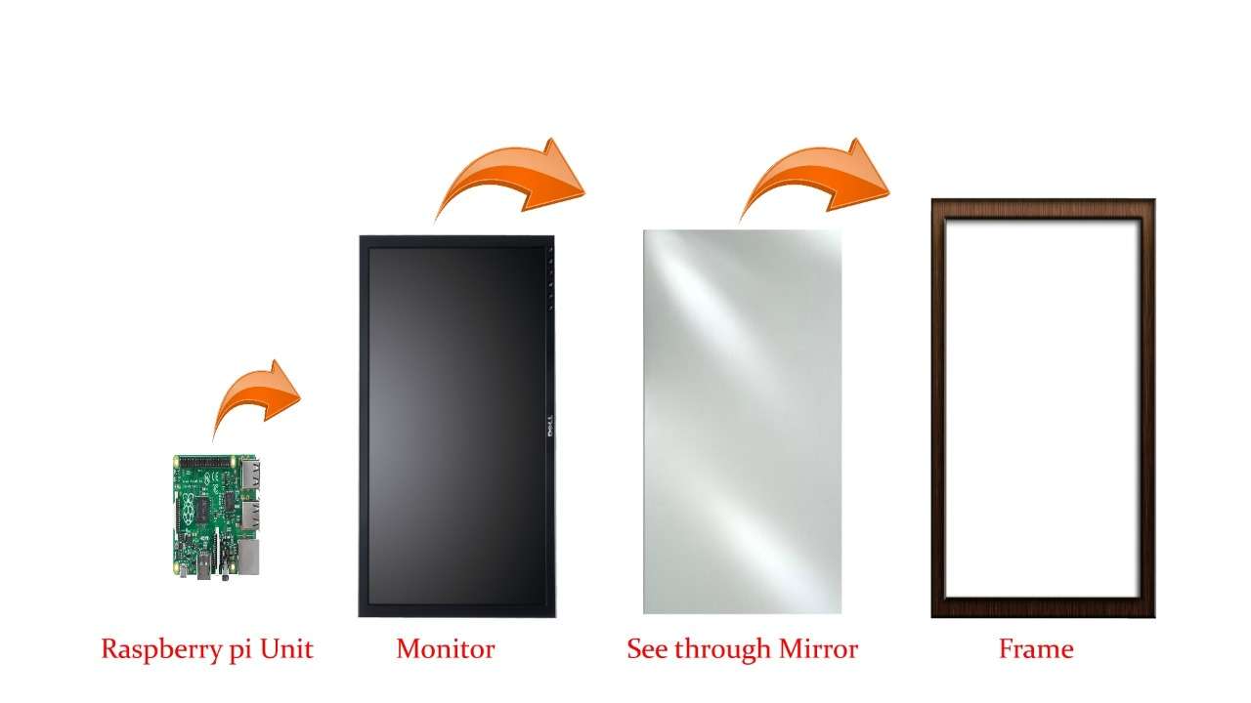
Hardware Block Diagram
Level 0

Slide 6



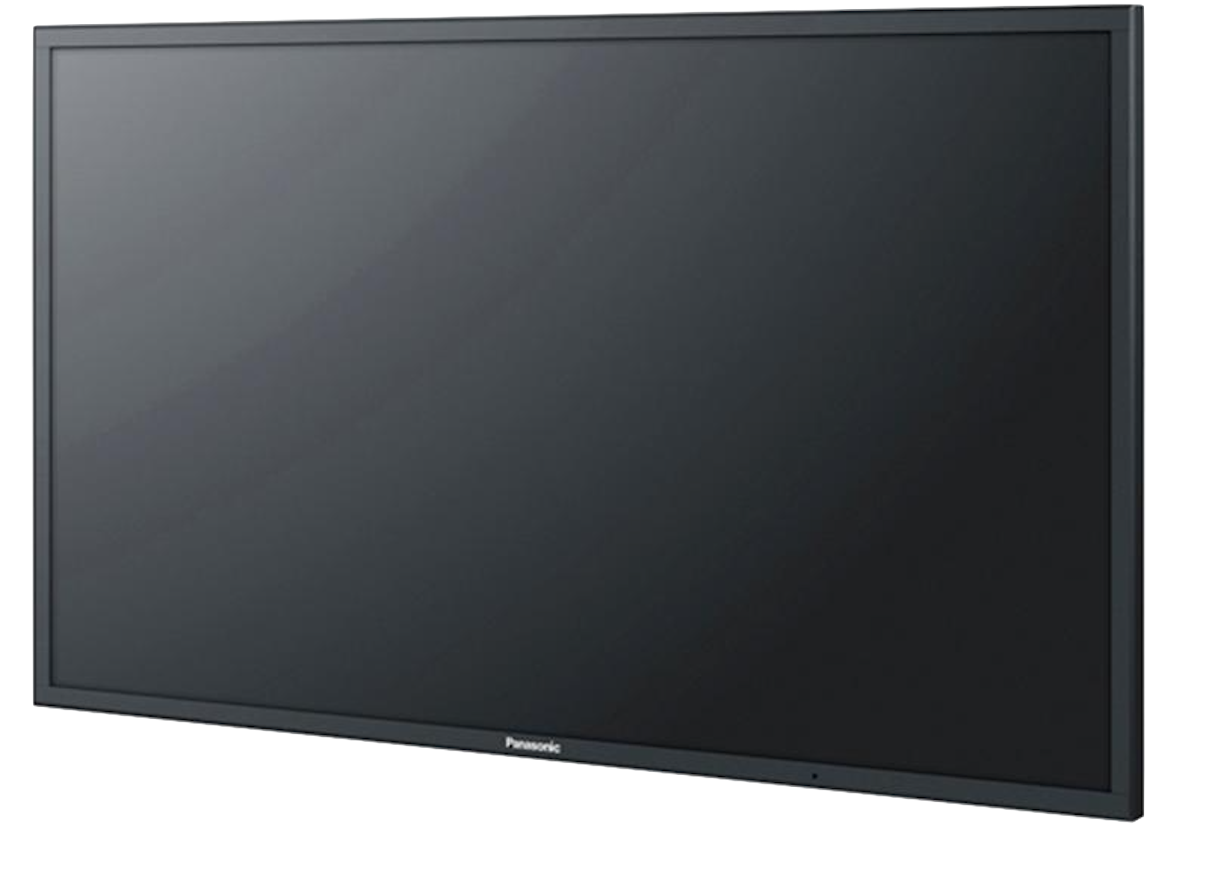
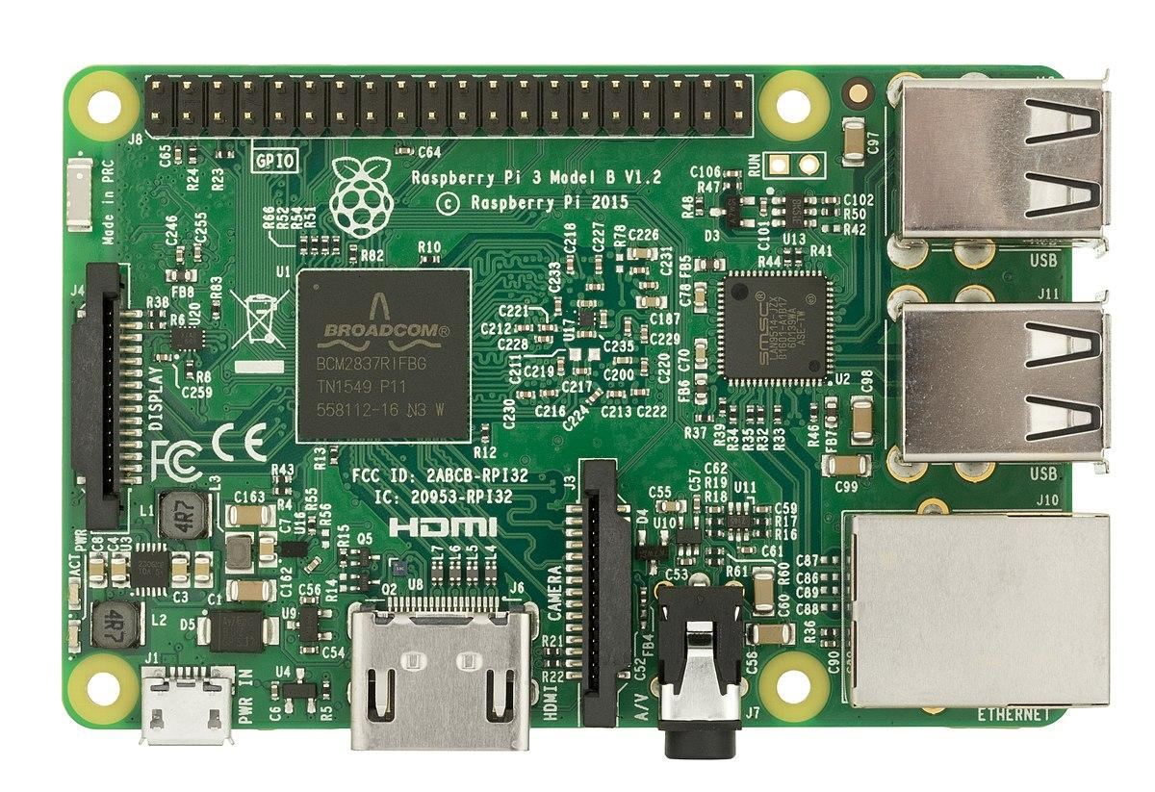

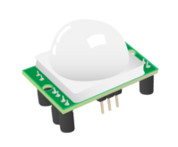


Hardware Block Diagram
Level 1
Internet
ESP8266
Led notification
Voice input
Led notification
Microphone
HDMI Output
Raspberry PI
Unit
Mirror display
Raspberry PI
Unit
Mirror display
Motion detection sensor
Audio Output
Motion detection sensor
Audio Output
Power

Slide 7
Software Components
Operating System for Raspberry PI: Raspbian OS
Front-end
Android application :react native
Mirror : HTML, JavaScript and CSS.
Back-end
JavaScript : Using NodeJS runtime
Python: For sensor and led manipulation
Ne DB: JavaScript database

Slide 8



Data Flow diagram
Cloud
Smart Mirror
System
Config
Android App
API calls:
Google Assistant
Music
Weather
Alexa
Time
News
Photos
User
Voice input
Display Output

Slide 9
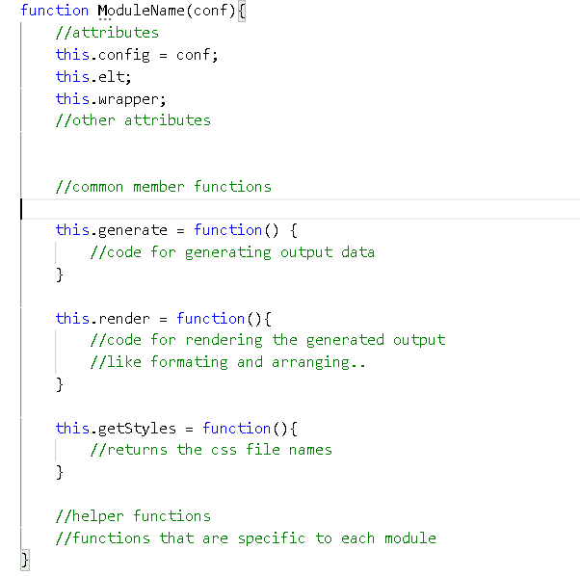
Common Module Structure
ModuleName
config elt wrapped generate() render() getStyles() helperfunctions()

Slide 10
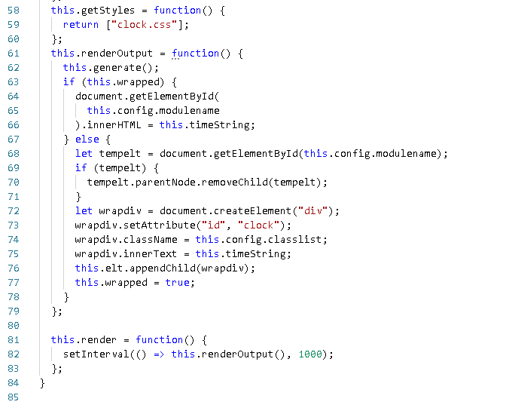
Clock Module
Clock
config wrapped elt timestring h, m, s generate() render() getStyles() addZero() secondsCheck()

Slide 11
Weather Module
api call
darksky
api
api_key
Weather
Config
location
response
openweather api
weather provider
api call
data to render

Slide 12
Weather Module cntd.
Weather
config wrapped elt appid fdata wdata generate() render() getStyles() get_icon() applyIcon() renderOutput() renderUpdate()

Slide 13
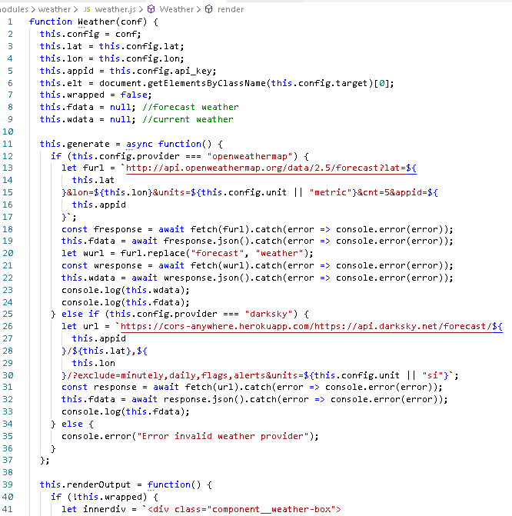
Code

Slide 14
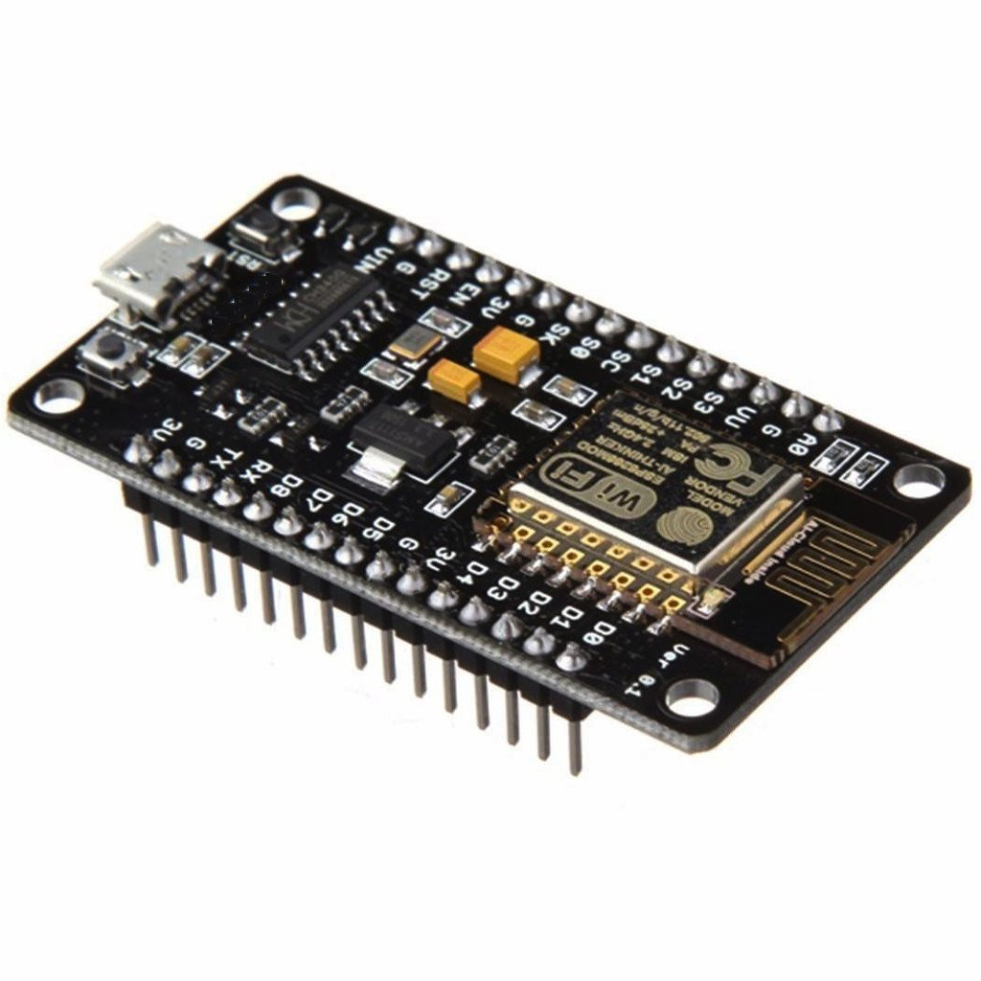
Esperto Switch
Acts as a switch to control the mirror.
Turns on and off power supply to the mirror based on google actions.
Implemented on esp8266 IoT chip
Used for scheduled ,voice controlled on and off.

Slide 15
google
actons
events
IFTTT
Esperto
Switch
Mirror
On or off
heartbeat
Esperto switch server
Command
IFTTT : if this then that, is a cloud platform for controlling IoT devices remotely based on various events.

Slide 16
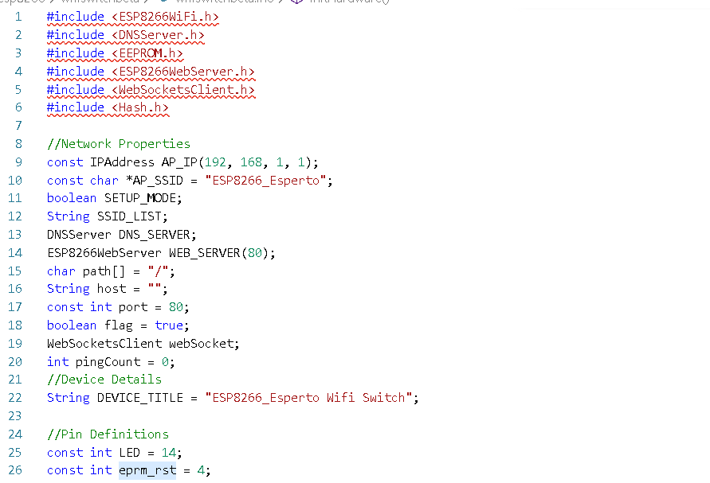
Code

Slide 17
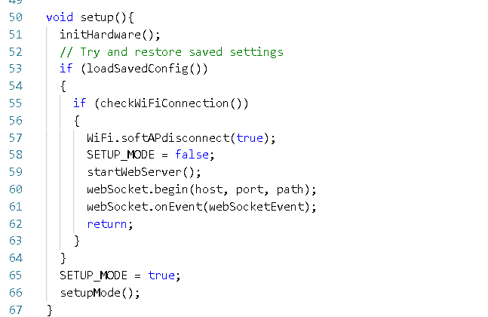
Code

Slide 18
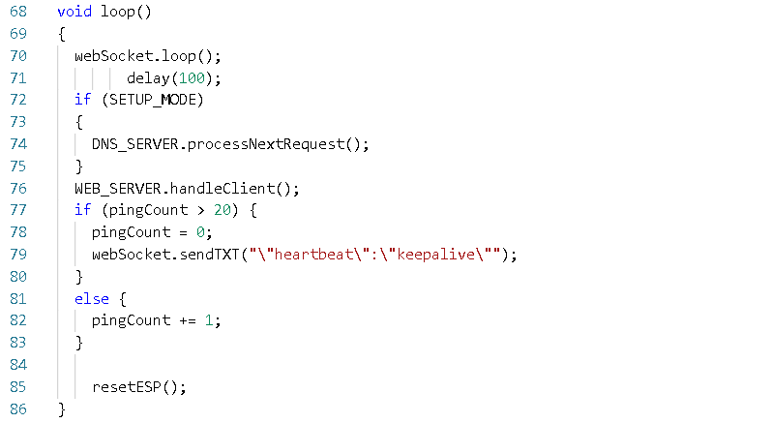
Code

Slide 19
Thank You

